Slide 1

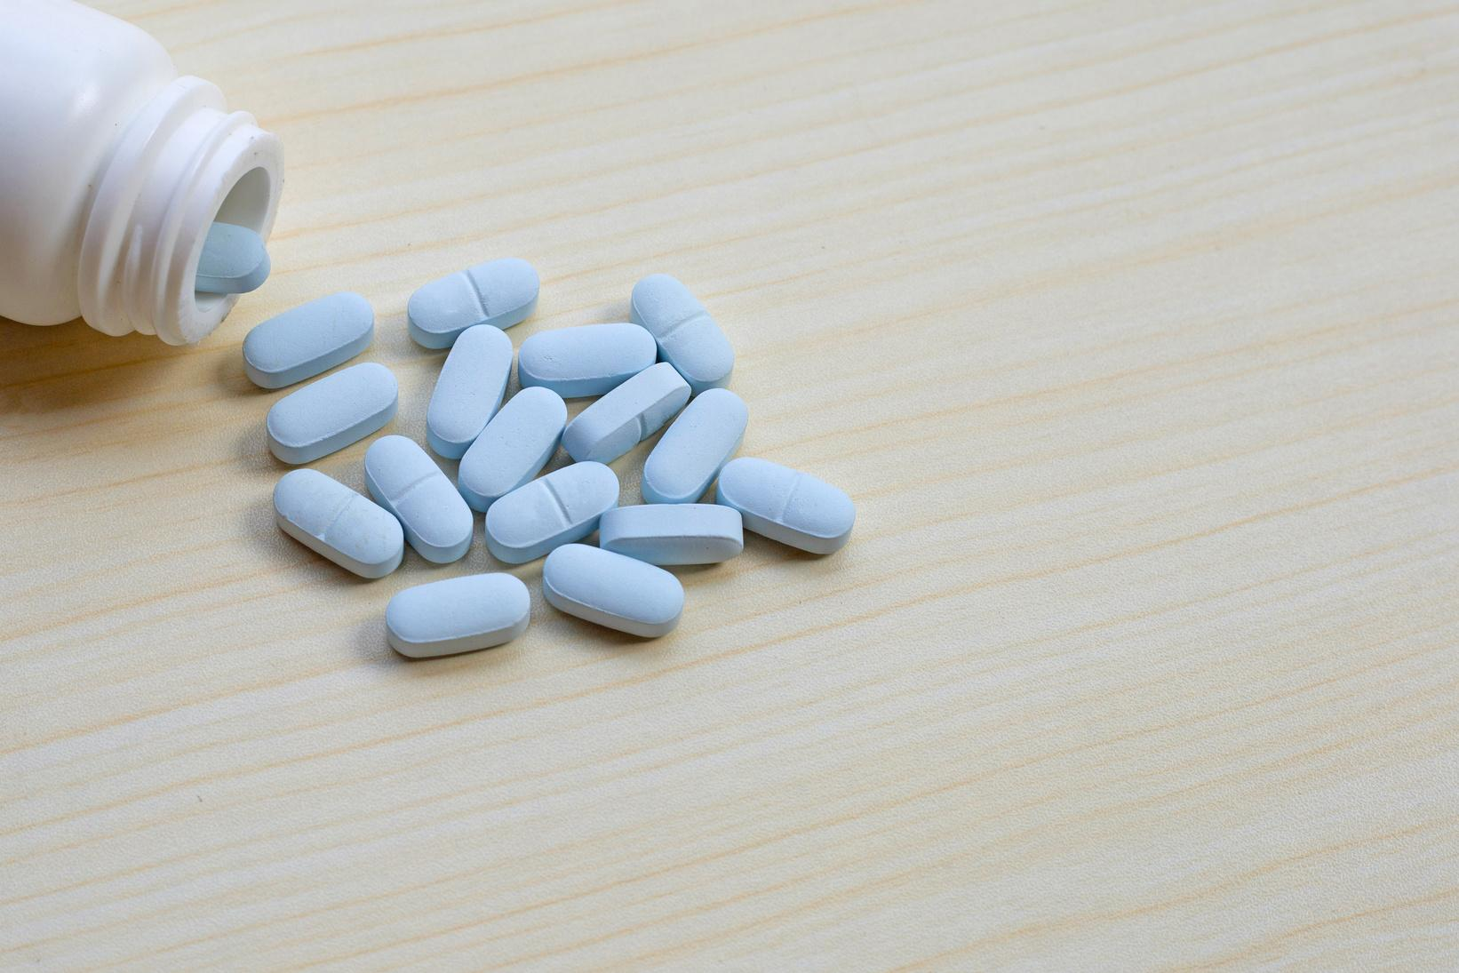

Identifying Barriers and Challenges to PrEP Uptake Among Cisgender and Transgender Black Women in Connecticut
ANNA PELC
YALE UNIVERSITY | 19 FEB 2025

Slide 2

Did you know ...
that black women make up
However, less than
58%
2%
of new HIV
infections.
of cisgender black women who are eligible for PrEP are able to access it.

Slide 3
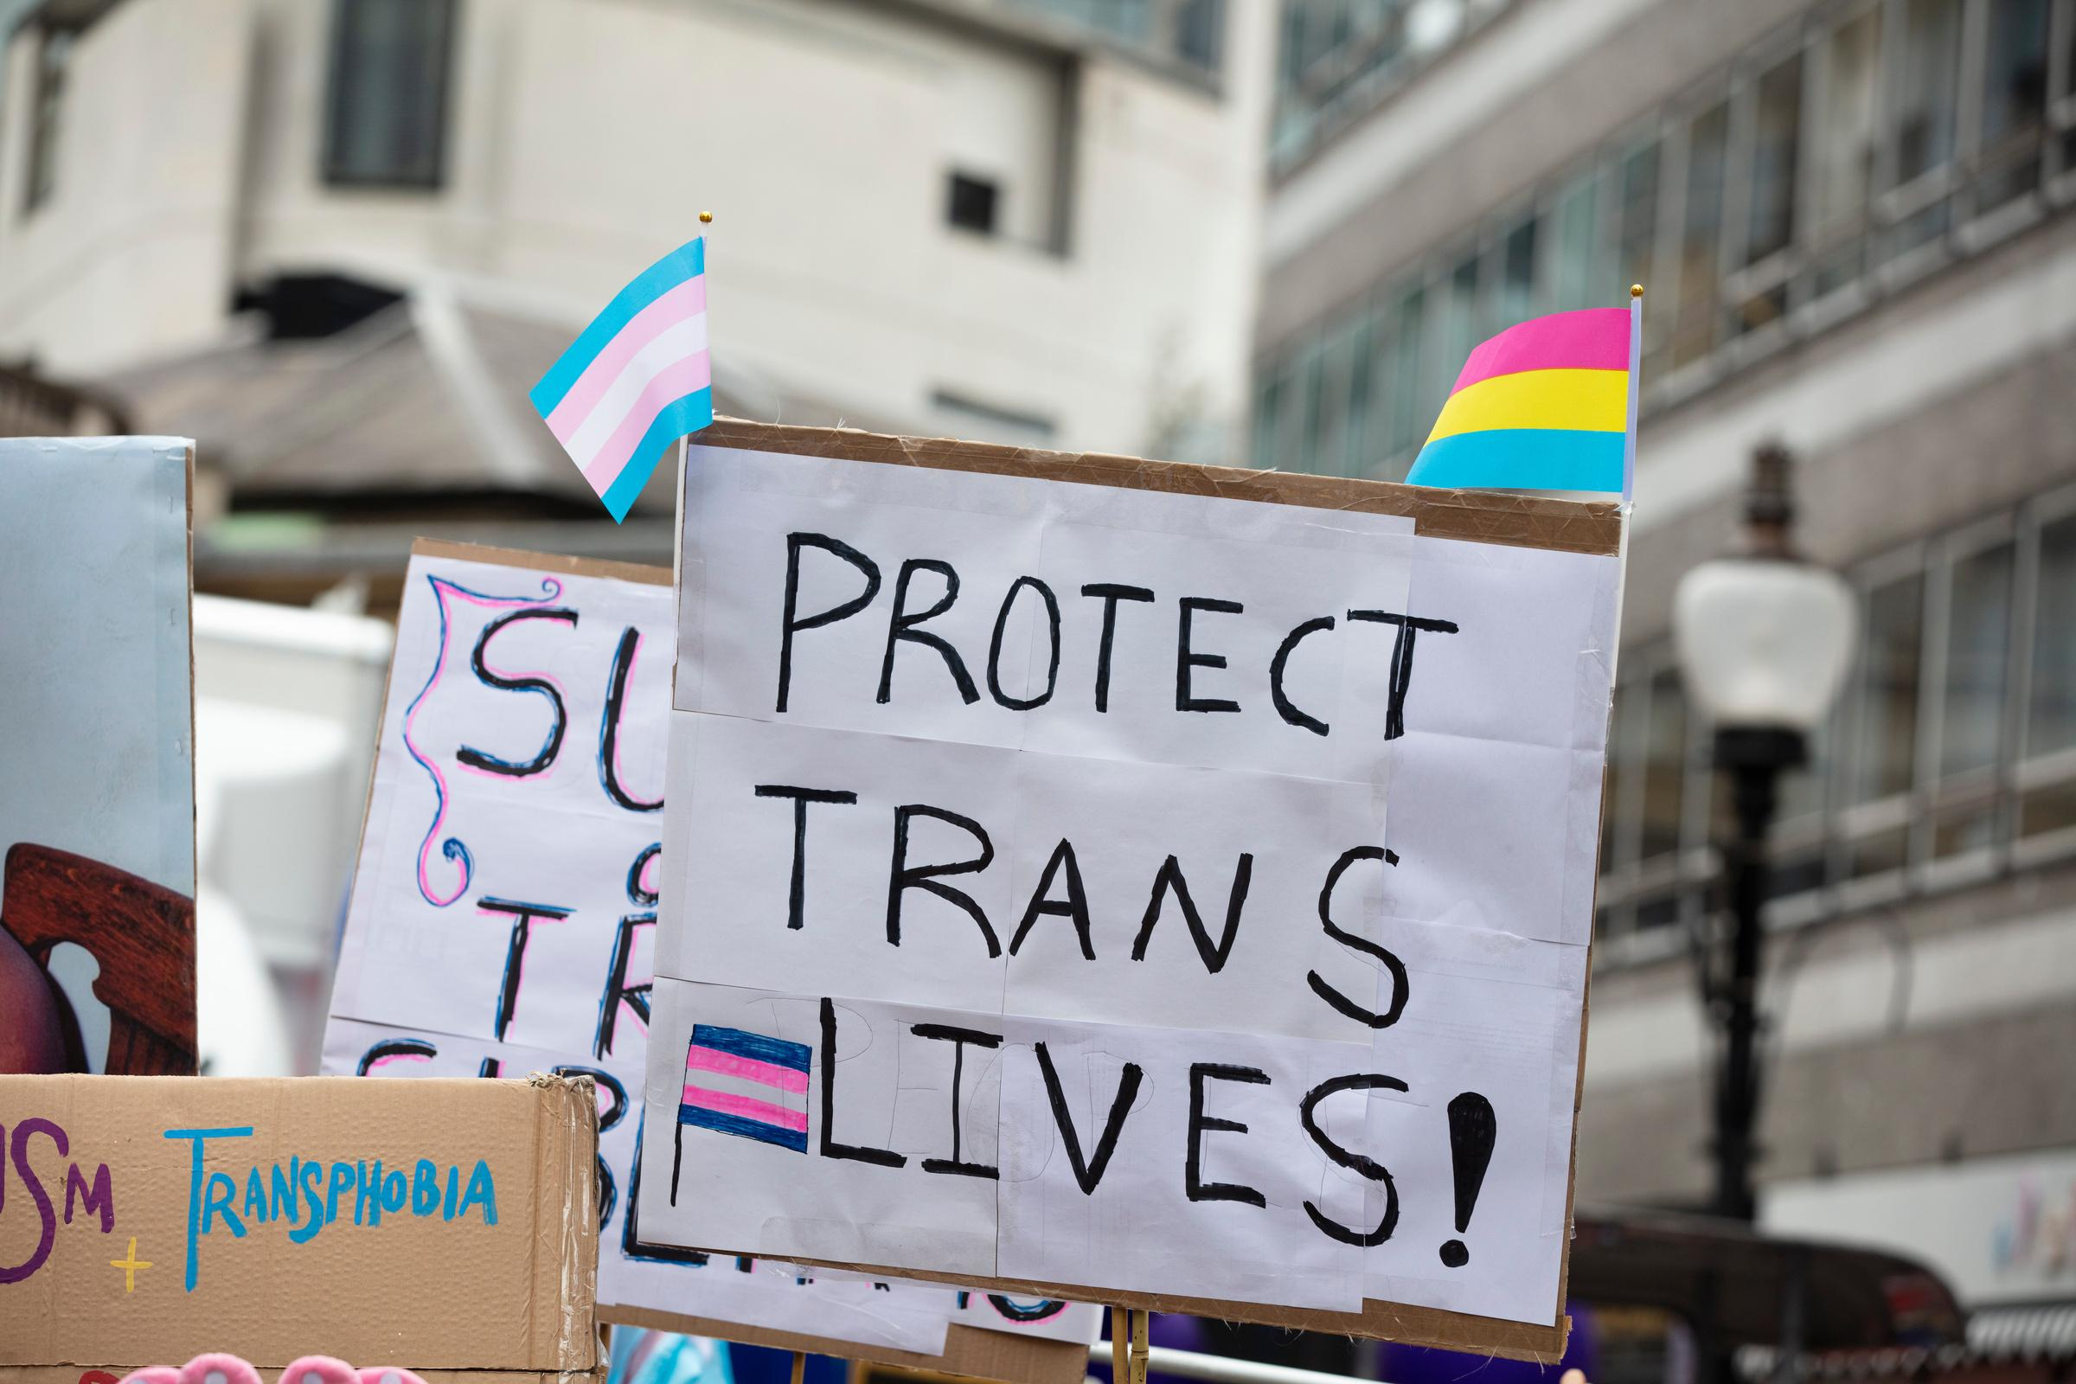
Did you know ...
that transgender women are
However, only
34x
3%
of sexually active transgender people are using PrEP.
more likely to have HIV
compared to the general population in the U.S.

Slide 4

Literature Review
Landscape Assessment
Interviews
  HIV & PrEP
  PrEP knowledge amongst women in the US
  PrEP knowledge amongst women globally
  Clinicians & PrEP
  Potential Solutions
  Online resources of state Departments of Public Health
  Discussions with PrEP Navigators
  Consent form
  Recruitment communication
  Recruitment flyers
  Informational brochures
  County-specific resource cards
Deliverables

Slide 5



Women & PrEP across the US
Chicago
Boston
•30% participants heard of PrEP; only 25% considered starting
•Concerns: side effects, stigma; perception of being wild; side effects; impact on reproduction; doctors pushing drugs; privacy; cost
•Concerns: pharma industry; being guinea pigs
Philadelphia
Mississippi
• 33% believed that PrEP would work and 27% were aware of PrEP
• Concerns: cost (44%) and side effects (39%)
•Limited awareness of PrEP, low perceived risk of contracting HIV, side effects, cost, limitations in marketing and distrust of healthcare system
Atlanta
Louisiana
•Lack of perceived risk
•Concerns: need to take pill everyday; someone finding out
•Only 37.5% initially interested
•Only 2.8% remained interested after learning about side effects

Slide 6
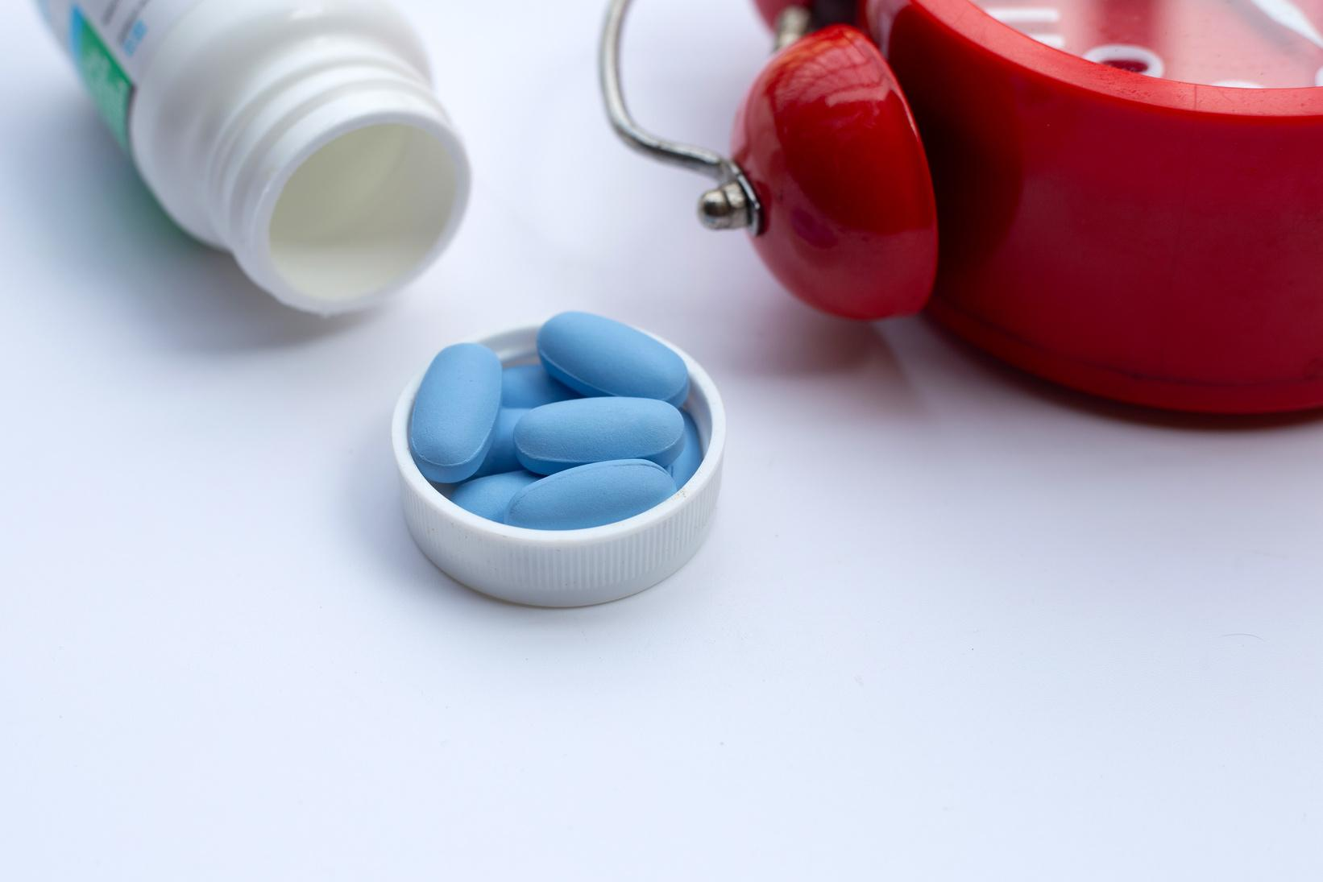





KEY FINDINGS FROM STUDIES IN TRANSGENDER INDIVIDUALS
Lack of awareness
  Only 13.7% had heard of PrEP in one study
PrEP candidates not willing to use it
Lack of trust in the medical system
Lack of culturally-competent healthcare providers
Fear of interactions with hormone therapies
Lack of integration between PrEP & hormone therapies
Lack of access to healthcare and social services

Slide 7

Clinicians & PrEP
Lack of awareness
  Only 38% of clinicians were able to correctly define PrEP
  Only 37% could correctly say how effective PrEP is
  Only 36% had seen a PrEP guide
  Not comfortable discussing sexual history
Concerns around
  Evidence
  Adherence
  Risk of coercion to engage in condomless or high-risk sex
  Continual monitoring for side effects & adherence

Slide 8

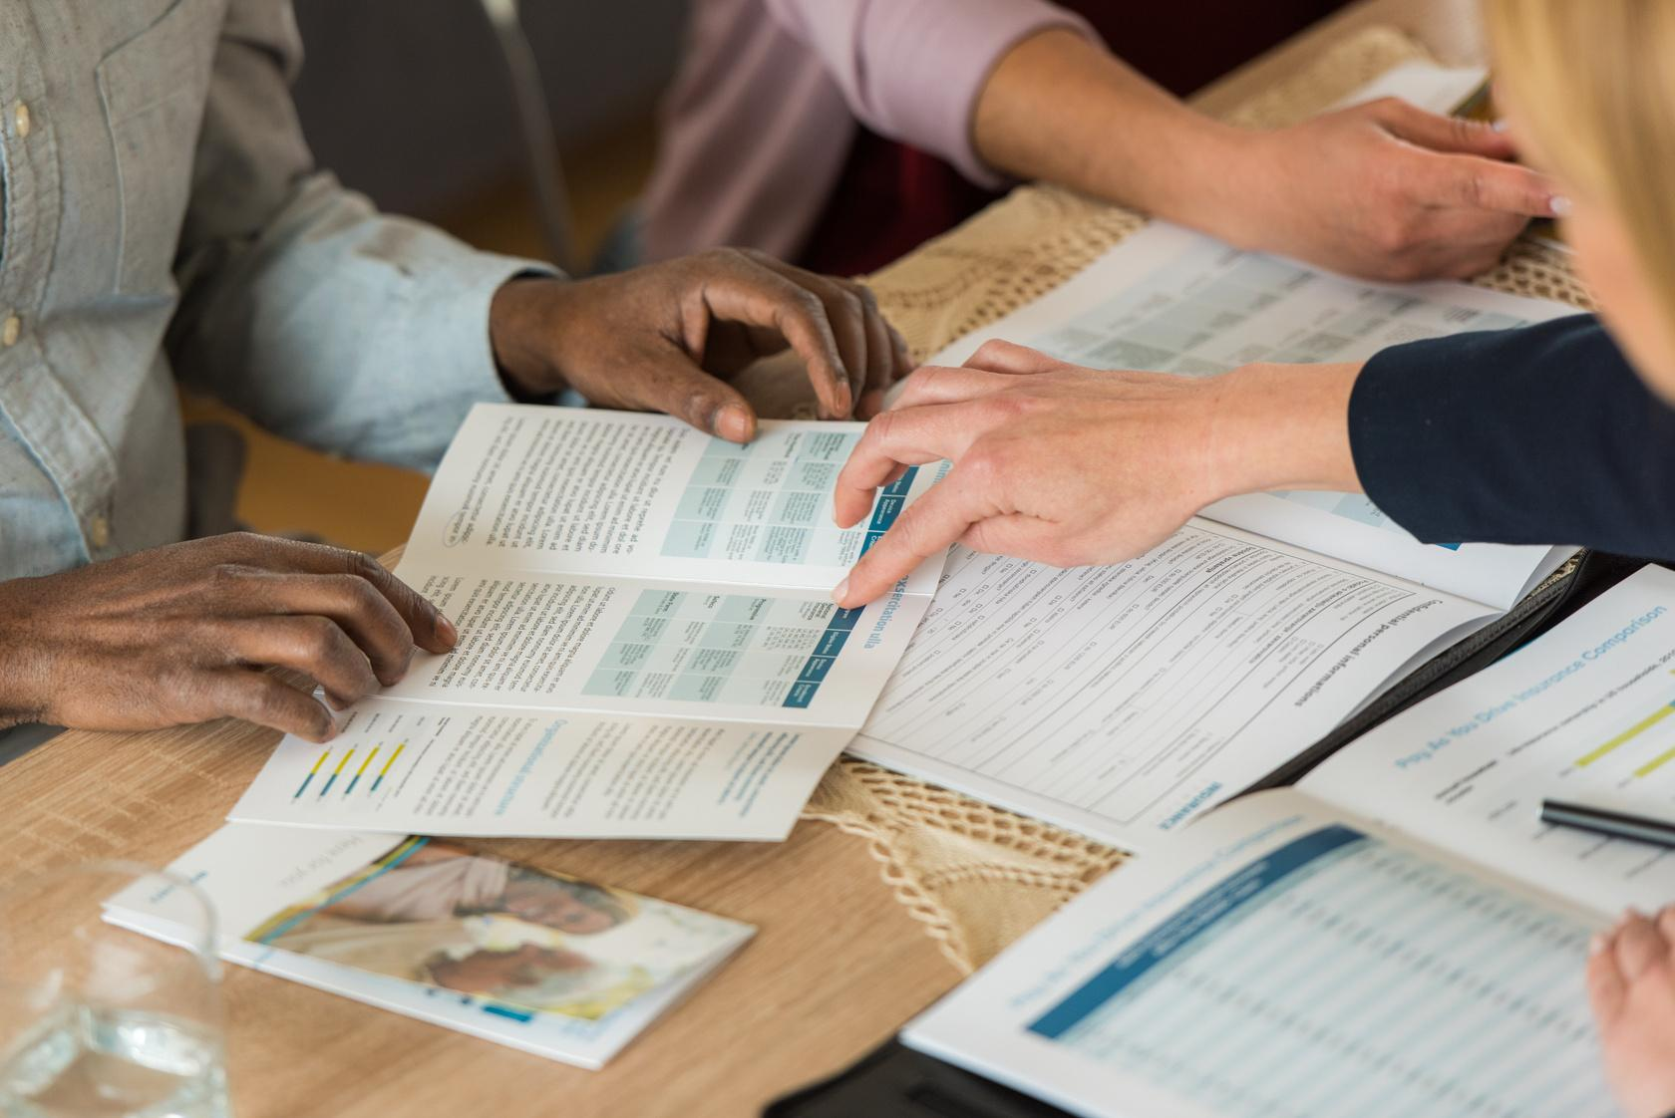






SOLUTIONS IN THE LITERATURE
Strategies to Improve PrEP Uptake
Support groups encouraging use & adherence
Integrating PrEP services with contraceptives & STI treatments
Workshops at women’s health events
Brochures & information in waiting rooms
Formal CDC guidelines
Youth-friendly PrEP programs

Slide 9






SOLUTIONS IN THE LITERATURE
Strategies to Improve PrEP Uptake
Having black women serve as educators
Continuing education credits for practitioners
Social media for demand creation
Culturally tailored interventions

Slide 10




FINDINGS FROM LANDSCAPE ASSESSMENT
Landscape Assessment
HIV resources
  State statistics
  New infections
General PrEP Information
  What is PrEP?
  How effective is PrEP?
PrEP locators
  Find local clinicians
  Find clinics that prescribe PrEP

Slide 11





FINDINGS FROM LANDSCAPE ASSESSMENT
Landscape Assessment
CDC Resources
  Links to available CDC resources
Patient Assistance
  Links to patient assistance programs i.e., Gilead
Physician Resources
  Billing codes
  How to take sexual history
  How to prescribe PrEP

Slide 12
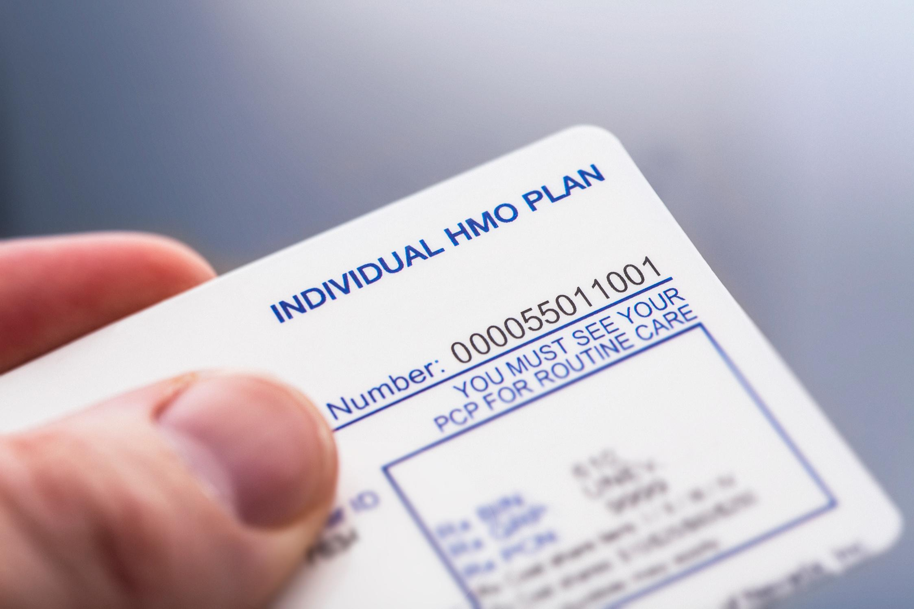
Iowa
Health insurance literacy
Challenges associated with health insurance literacy
Side effects rarely issue
If clients are adequately informed, side effects are rarely an issue
Not prescribing PrEP
Healthcare providers not always willing to prescribe PrEP
KEY LEARNINGS FROM PREP NAVIGATOR DISCUSSIONS

Slide 13

KEY LEARNINGS FROM PREP NAVIGATOR DISCUSSIONS
North Carolina
  Advertisements focused on men
  Forgetting to take PrEP
    Pill wheel to help

Slide 14

Washington DC
  Focus on pleasure since risk language is stigmatizing
  Leveraging sister circles to spread information
KEY LEARNINGS FROM PREP NAVIGATOR DISCUSSIONS

Slide 15



KEY LEARNINGS FROM PREPARING INTERVIEW GUIDE
  PrEP questions
  Awareness & knowledge of PrEP
  Perspectives on PrEP
  Comfort discussing PrEP
  Barriers to taking PrEP
  Opportunities to improve PrEP use
Study Sample
Inclusion criteria:
  Black cisgender or transgender women
  18 years and older
  Residents of Connecticut
Interview Guide
Development

Slide 16

Purpose of study
“The responses that you provide will help us learn more about PrEP awareness, perspectives and barriers, and opportunities to improve PrEP use and PrEP services.”
Consent Form Development
Risks & benefits
of participating
“You might feel that certain questions are personal in nature and address sensitive topics. This might lead to some discomfort. The research might also not directly benefit you. The benefit of participating in this study is that information you provide could help to identify opportunities to improve PrEP use and PrEP services. You might also learn more about PrEP and its benefits.”
“We are also requesting your permission to audio record you as part of this study. If you agree to the recording, we will use it for analyzing the responses to identify themes and opportunities to improve PrEP uptake. If you do not wish to be recorded, notes will be taken instead.”
Audio recording
Compensation
“You will receive $20 in a Walmart gift card for your participation.”

Slide 17




Recruitment Communication
Purpose of study
“These interviews will help the researchers learn more about PrEP awareness, perspectives and barriers, and opportunities to improve PrEP use and PrEP services.”
Details on interview
“The interview will take about 1 hour of your time and will be done virtually... You will be able to stop the interview at any time, or skip questions, if you do not keep comfortable answering them.”
Risks and benefits
“In this study, there is a risk of loss of confidentiality. You might also feel that certain questions are personal in nature and touch on sensitive topics. This might lead to some discomfort. The research might also not directly benefit you....”

Slide 18



Slide 19



Slide 20




Comfort discussing PrEP
  Generally feel comfortable discussing PrEP with medical providers, friends and family members
  Concerns around discussing PrEP with partners as it might make it appear as if they are not trusted
Societal stigma
  Highlighted societal stigma and racism as barriers
  Concerns around others assuming that they have HIV if they say they are taking PrEP
Daily pill & side effects
  Concerns around taking a daily pill (i.e., forgetting)
  Concerns around side effects, especially stomach pain and headache
KEY FINDINGS FROM INTERVIEWS
Interviews

Slide 21



Conclusions
Black women experience barriers to taking PrEP as a daily pill
Concerned about the side effects
Comfortable discussing PrEP with medical providers and peers
Uncomfortable speaking with their partners about PrEP
Providing counseling and clinical education may help to increase uptake

Slide 22
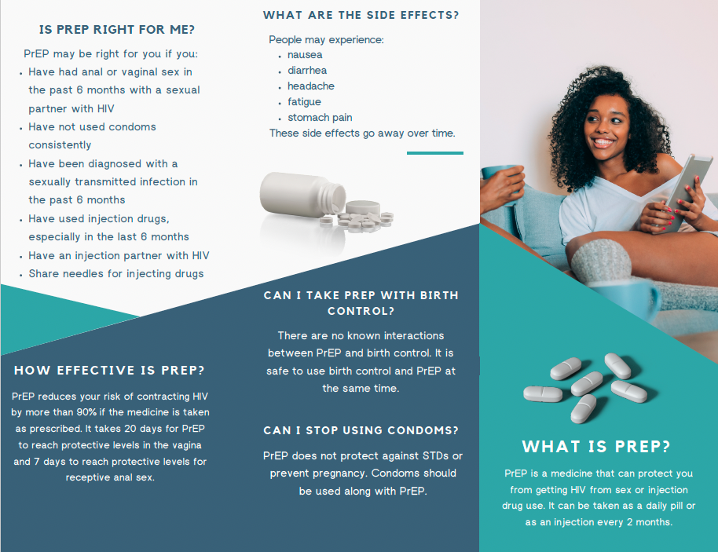

Slide 23
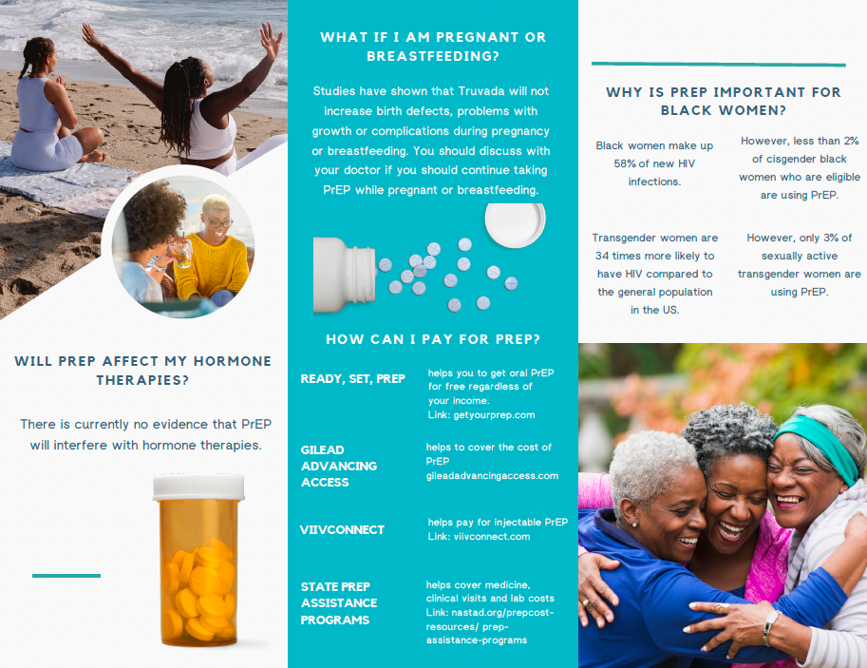

Slide 24
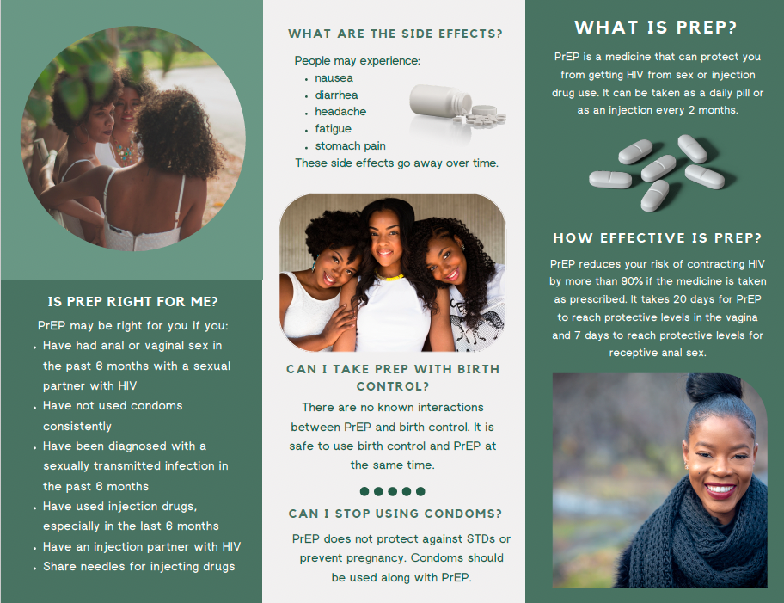

Slide 25
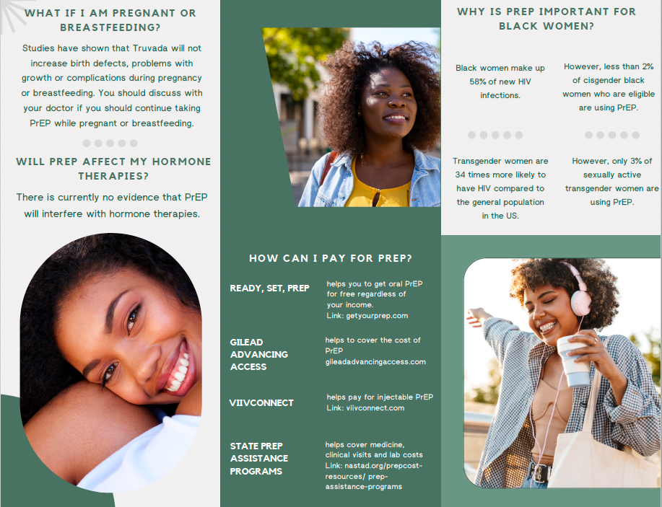

Slide 26
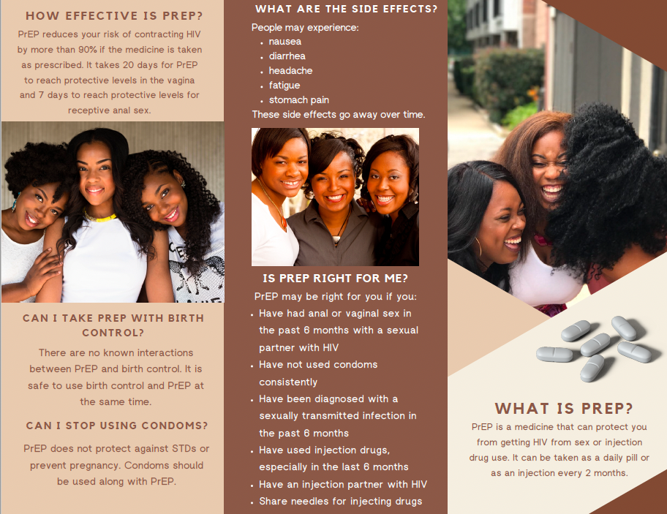

Slide 27
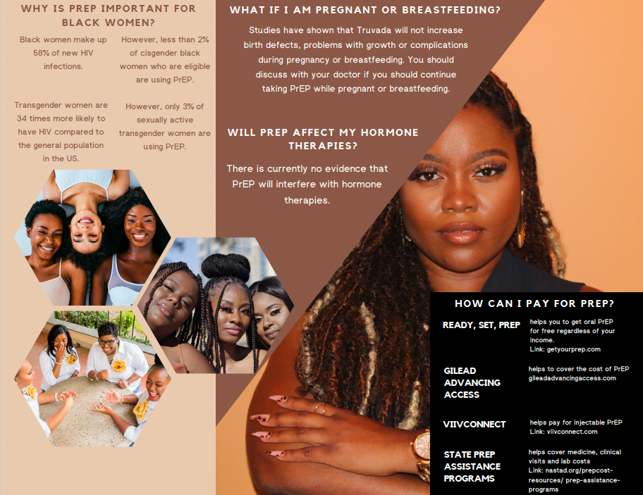

Slide 28
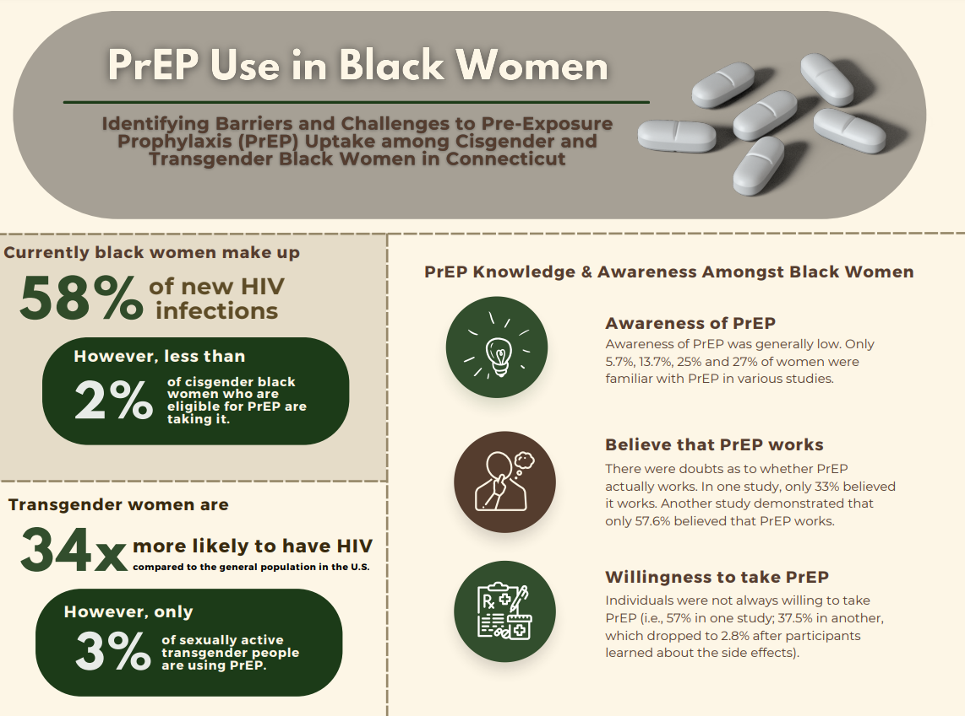

Slide 29
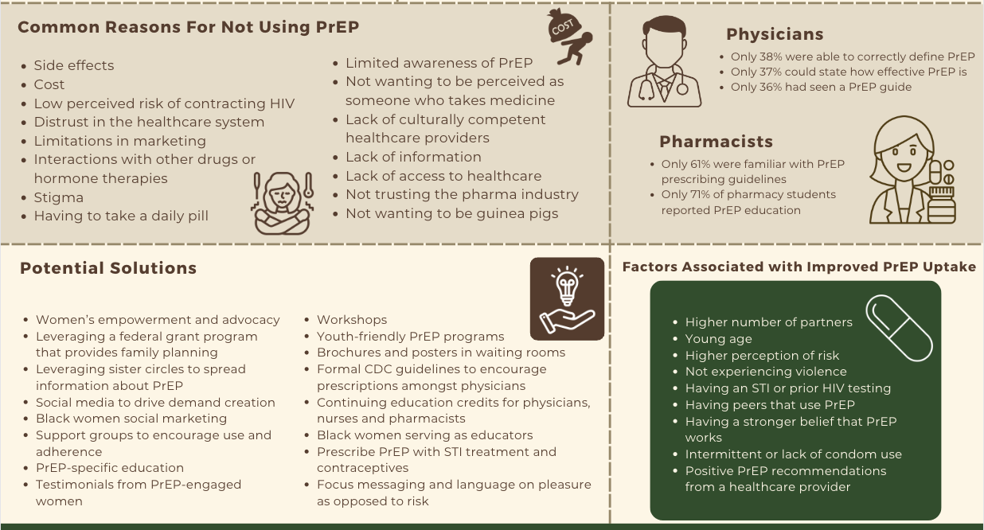

Slide 30
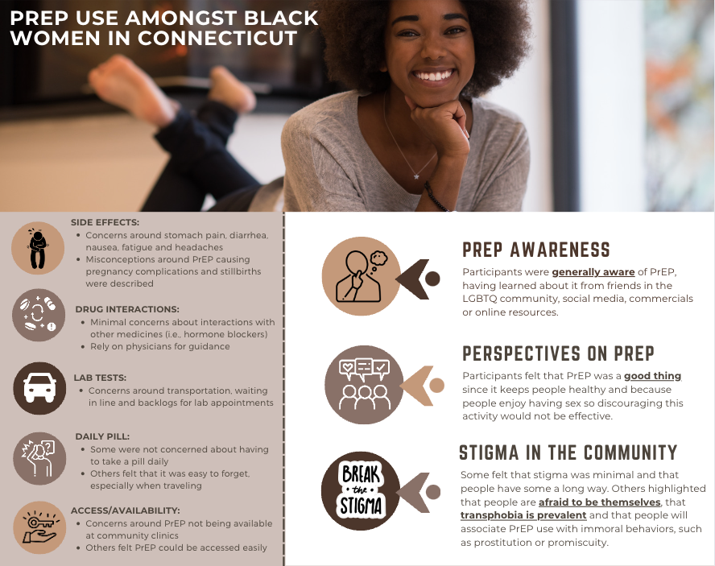

Slide 31
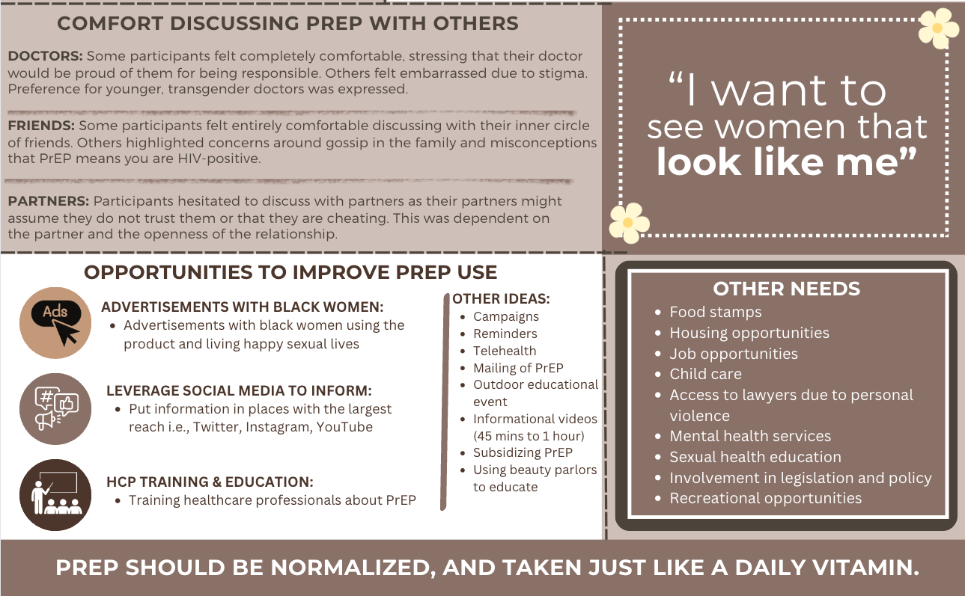

Slide 32
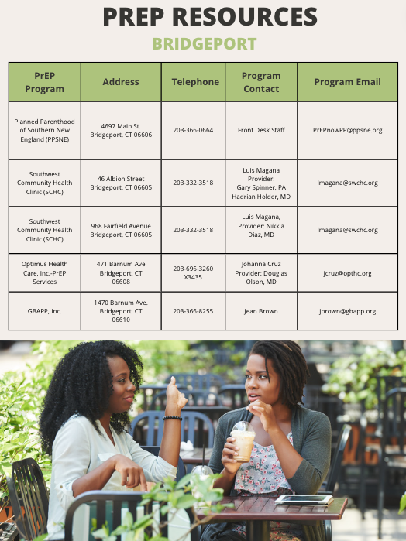
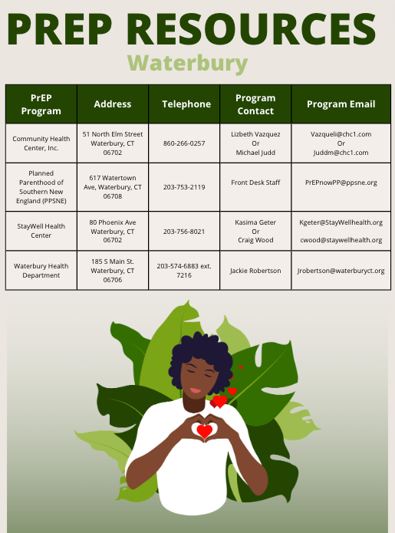

Slide 33
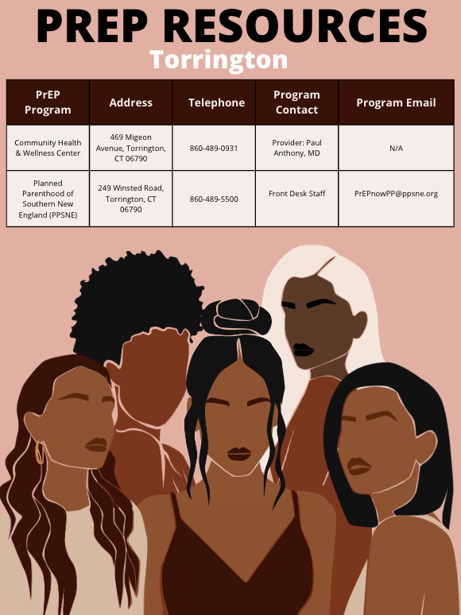
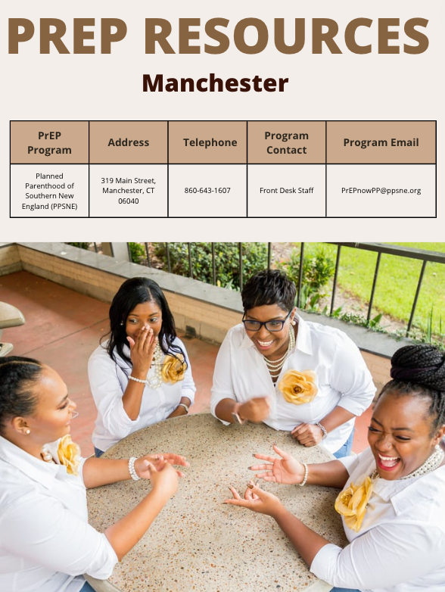

Slide 34
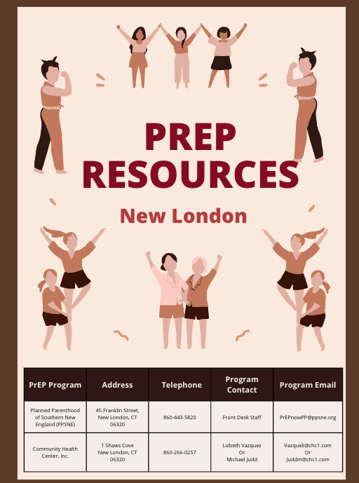
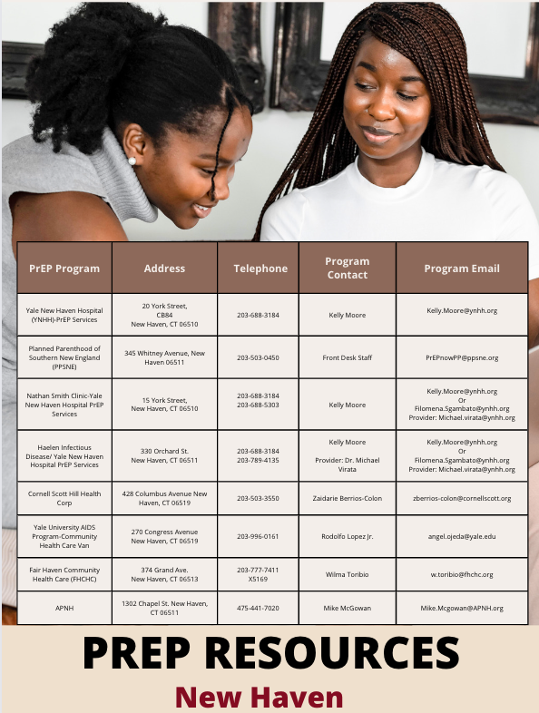

Slide 35

Questions?

