Slide 1
PrEP Data Update
February 19, 2025

Slide 2
Limitations
HIV-negative
Screened for PrEP
Eligible for PrEP
Referred to PrEP Provider
AIDSVu Data

Slide 3
PrEP Data Limitations
Limitations:
All data is self-reported information unless specified
Some agencies automatically upload data onto EvaluationWeb and have been experiencing trouble reporting PrEP variables. CTPH is working closely with these agencies.
The data presented is not in real-time.
Analysis:
Descriptive data analysis was conducted using Microsoft Excel
Source:
Data reflects information obtained from EvaluationWeb (i.e., data collection system) from January 1, 2021, to November 15, 2024, and analyzed on January 22, 2025.

Slide 4
People Who Tested HIV-Negative
Jan 1, 2021, to Nov 15, 2024

Slide 5
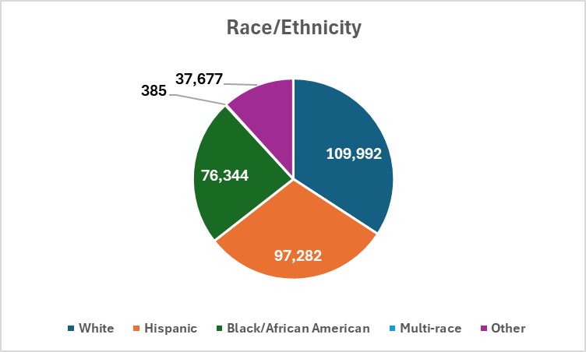
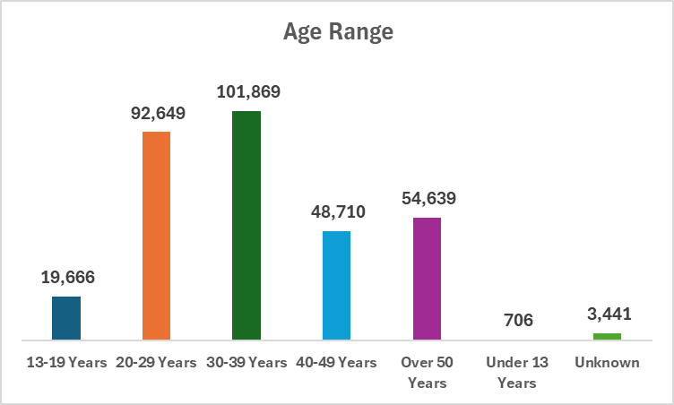
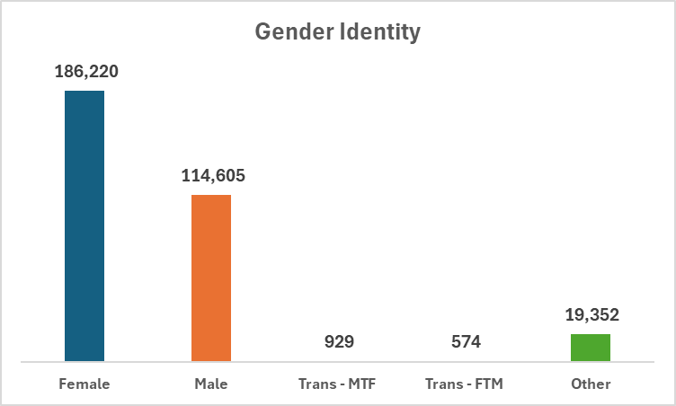
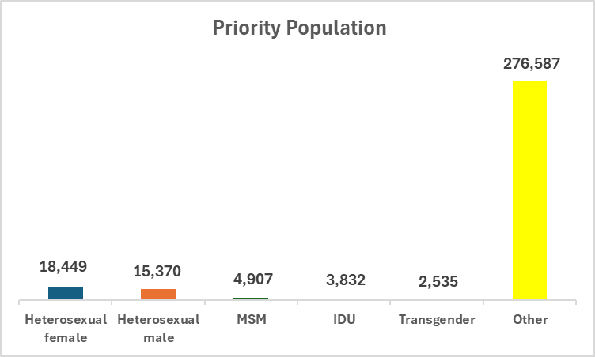
Number of people who tested HIV-negative, Jan 1, 2021, to Nov 15, 2024; N= 321,680

Slide 6
People Screened for PrEP,
Jan 1, 2021, to Nov 15, 2024

Slide 7
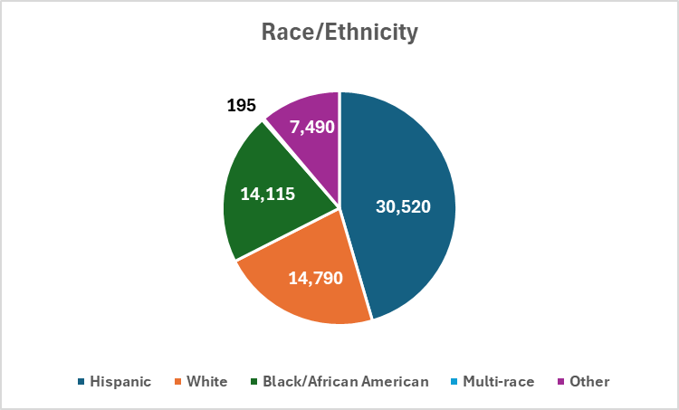
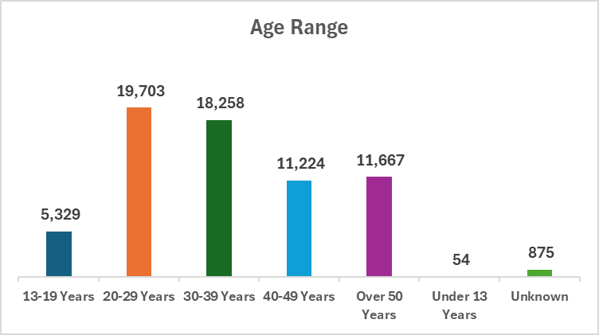
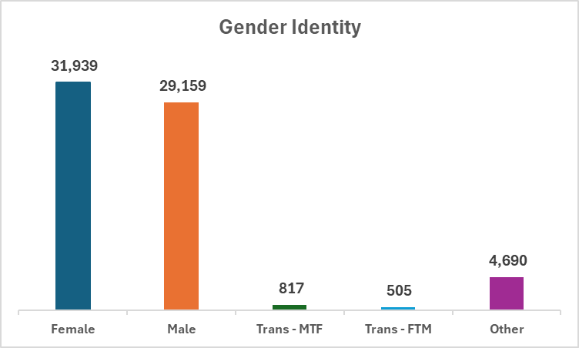
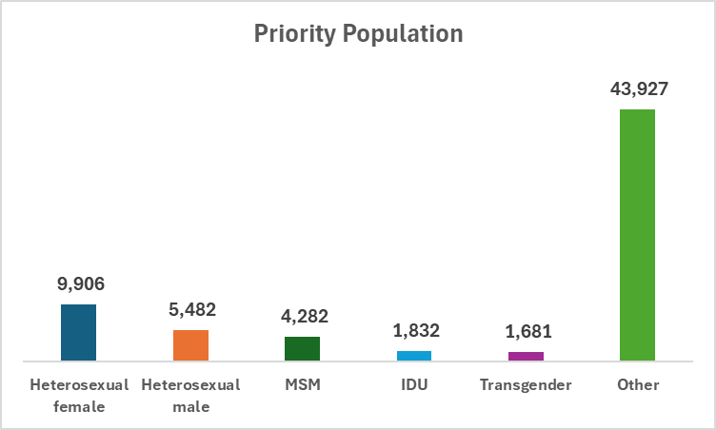
Number of people who were screened for PrEP, Jan 1, 2021, to Nov 15, 2024; n= 67,110

Slide 8
People Eligible for PrEP,
Jan 1, 2021, to Nov 15, 2024

Slide 9
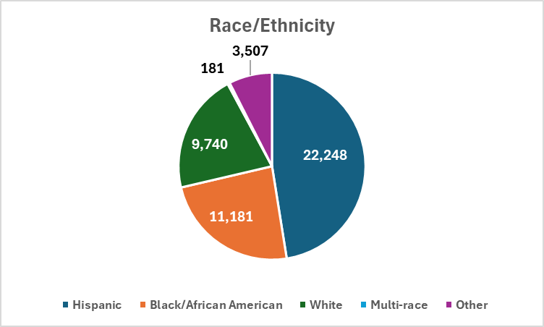
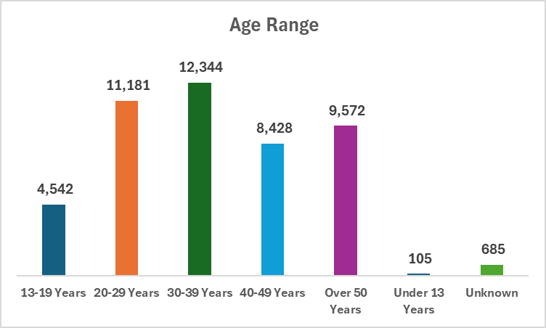
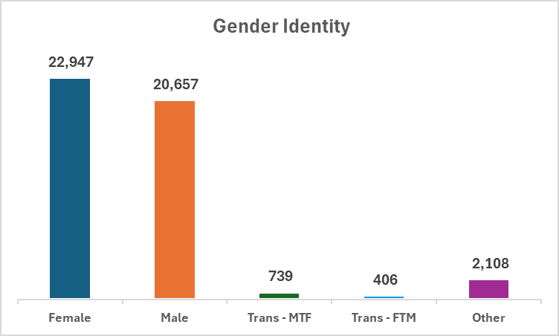
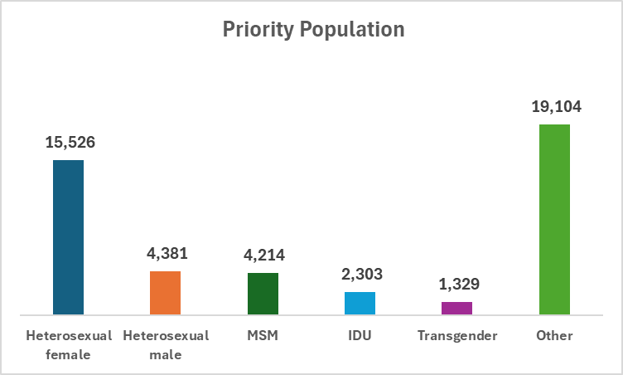
Number of people who were eligible for PrEP, Jan 1, 2021, to Nov 15, 2024; n= 46,857

Slide 10
People Referred to a PrEP Provider,
Jan 1, 2021, to Nov 15, 2024

Slide 11
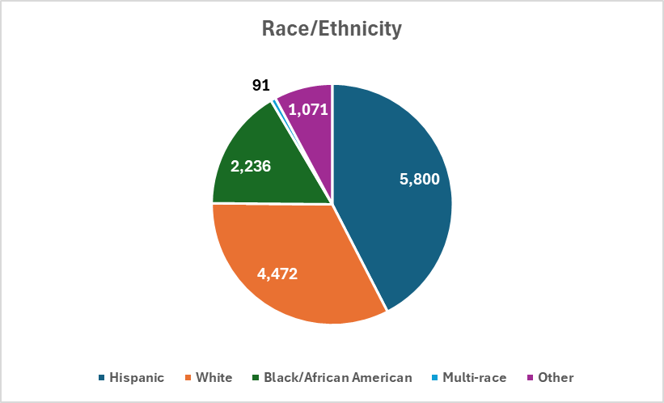
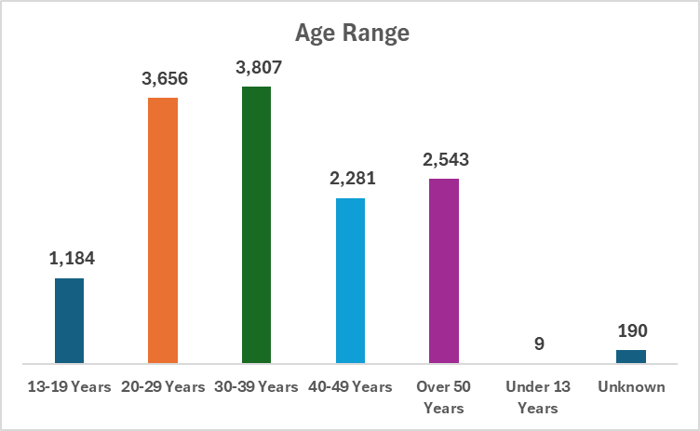
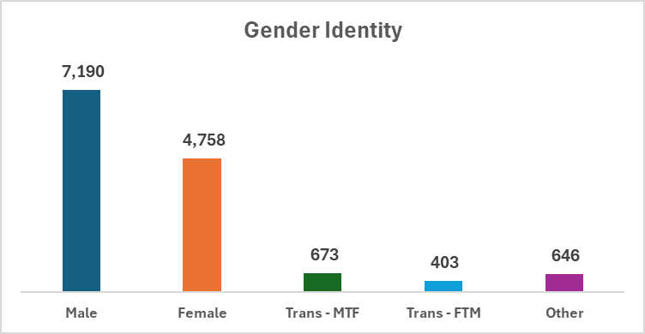
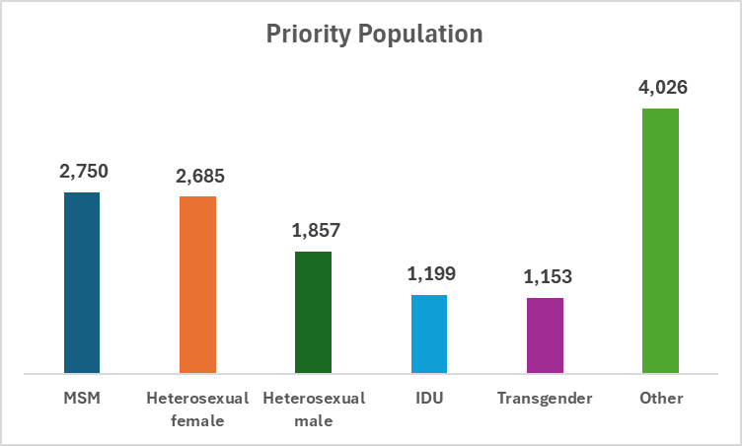
Number of people referred to a PrEP provider, Jan 1, 2021 to Nov 15, 2024; n= 13,670

Slide 12
AIDSVu PrEP Data

Slide 13
Prevention & Testing in Connecticut, AIDSVu, 2023
Overview
Preventing HIV is possible thanks to diverse strategies that are becoming more widely available. Use of preventative HIV medication and increased testing have proven effective in reducing new cases.
The following summarizes prevention strategies and outcomes in Connecticut:
Pre-Exposure Prophylaxis (PrEP)= 152 users/100K
4,743 people received PrEP to reduce the chances of getting HIV in 2023
PrEP-to-Need Ratio (PnR)= 21.6
PnR reflects how well the need for PrEP was addressed in 2023
HIV Testing= 39.5%
A survey estimate of residents who were tested for HIV at least once in their lifetime as of 2022

Slide 14
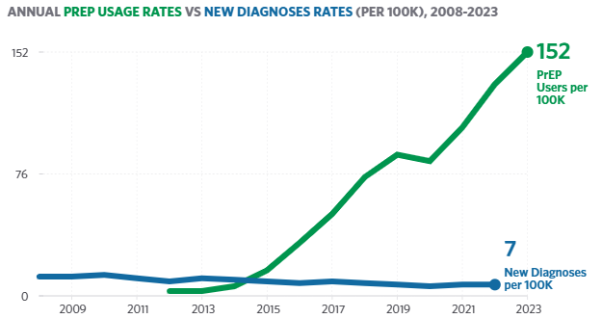
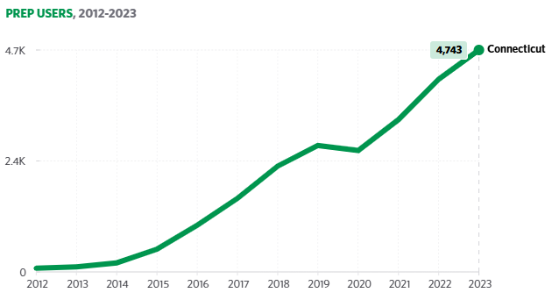
PrEP in Connecticut, AIDSVu, 2023
Pre-exposure prophylaxis (PrEP) is a highly effective medication that reduces the risk of getting HIV. Ongoing efforts to raise awareness, improve accessibility, and ensure affordability are instrumental in HIV reduction

Slide 15
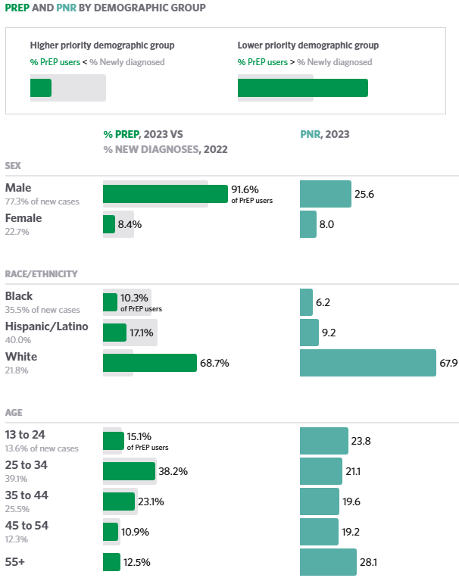
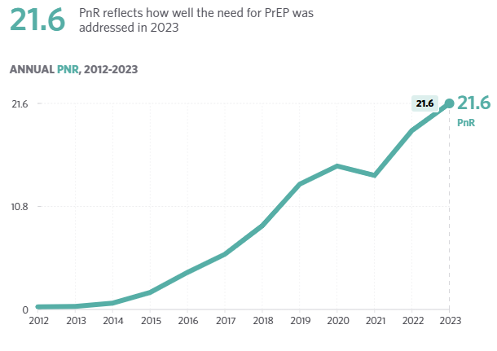
PrEP-to-Need Ration (PnR) in Connecticut, AIDSVu, 2023
To identify gaps in PrEP prevention, PrEP-to-Need Ratio (PnR) compares the number of people using PrEP to the number of people newly diagnosed with HIV. This shows how well PrEP usage aligns with need for HIV prevention. A lower PnR indicates more unmet need for PrEP.

Slide 17
Luis F. Díaz-Matos Epidemiologist TB, HIV, STD & Viral Hepatitis Programs
Luis.Diaz@ct.gov
860-509-7418

