Slide 1


Introduction to the Quality & Performance Measures Team
Setting Expectations and Making Impact!
January 15, 2025

Slide 2
You Are In The Right Place If..
You value impact, alignment and improvement
You believe there is always a way to be better
You implement quality as a standard practice
You are interested in being part of a quality improvement team
You appreciate how data can improve quality

Slide 3

QPM Committee Charge
Review and discuss data
Develop indicators to track our progress in ending the syndemic
Help improve the quality of HIV Prevention and Care in CT

Slide 4

Charge #1: Review and Discuss Data
-Review and discuss data on team-identified priority topics and Plan indicators
-Presentations at CHPC meetings, with ‘deeper dives’ in QPM
-2025 topics to include:
  PrEP
  Linkage to Care / Rapid Start

Slide 5

Why Data? Numbers = People
Numbers = people
Numbers drive decision-making
  Assess attitudes and perceptions including customer satisfaction and experience
  Document needs and gaps
  Measure performance
  Improve services
  Show impact of the resources used
Numbers = resources

Slide 6
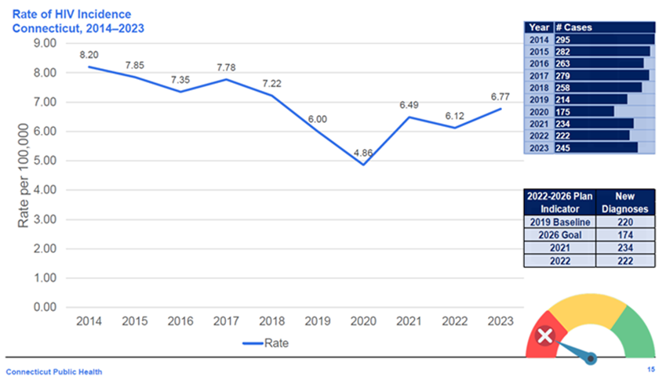
Charge #2: Develop &Track Indicators
Annual review of progress on indicators
Update indicators for 2027-31 Plan

Slide 7
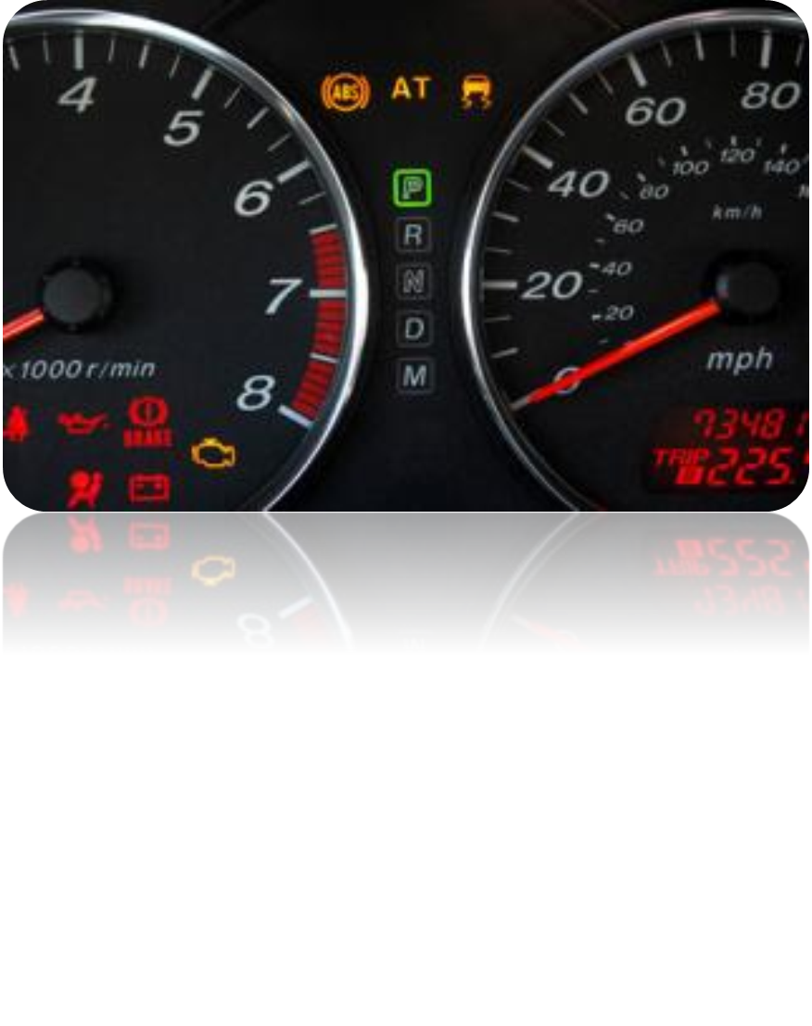
Indicators Show Us How are we doing

Slide 8

Committee Charge #3 Support Statewide Quality Improvement (QI) Efforts
Share the results of QI projects across the different Ryan White Parts – promising practices and lessons learned
Use data to identify future QI projects on key topics
Hold an annual Quality Summit

Slide 9

How does the work of the QPM Team align with the Integrated Plan?
Let’s Talk Alignment

Slide 10
QPM Alignment
QPM activities cut across all 4 Plan goals
QPM has focused on:
  Objective 1.2: decrease disparities in new HIV diagnoses
  Objective 2.4: increase housing access
  Objective 3.1: develop stigma indicator
  Objective 4.3: monitor Plan implementation

Slide 11
INITIAL 2025 QPM WORKPLAN
What Will Our Work Look Like This Year?

Slide 12
QPM Meetings
Month | Topic(s) | Month | Topic(s)
Jan | Orientation, QI Projects | Jun | QI Spotlight, Planning Quality Summit
Feb | PrEP | Jul | 2023 Indicator Data
Mar | QI Spotlight, Plan Indicators | Sep | Dats Presentation, Quality Summit Prep
Apr | Linkage to Care / Rapid Start | Oct | Quality Summit
May | Plan Indicators and Goals | Nov | QI Focus Areas, 2026 Priorities

Slide 13

We Want To Hear From You
Please complete the poll to decide on a topic for the September data presentation

Slide 14

‘QI Spotlight’ Mini-Presentations
Highlight several QI projects at QPM meetings this year
Brief presentations (10-15 minutes)
Members can volunteer or nominate a project
  Projects that address a key focus area and/or generate lots of lessons learned / insights / new ideas for improvement

Slide 15
What Is Expected of a QPM Team Member
Actively engage in our discussions and decision making
Share your jurisdictions’ QI efforts
Bring our discussions back to your agency
Implement any new QI tips that you have learned
Help us continuously improve as a planning body

